Slide 1
CAKE CAFE PRESANTATION
CAKE CAFE IN USUALLY WEBSITE.

Slide 2
CAKE CAFE
A SWEET BAKED FOOD MADE FROM A DOUGH OR THICK BATTER USALLY CONTAINING FLOUR AND SUGAR AND OFTEN SHORTENING,EGGS,AND A RAISING AGENT.

Slide 3
SLIDE TITLE
MAKE EFFECTIVE PRESENATION.
USING AWESOME BACKGROUNDS.
ENGAGE YOUR AUDIENCE.
CAPUTE AUDIENCE ATTENTION.

Slide 4
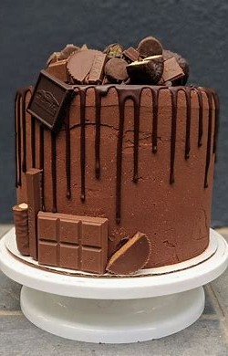
CHOCLATE CAKE.
See the best cake recipes. Trusted recipes for chocolate cake, white cake, banana cakes, and carrot cakes with photos and tips from home cooks.

Slide 5
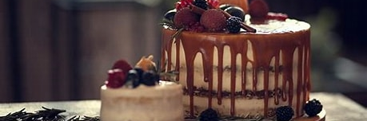
CAKE BACKGROUND IMAGE.
DIFFERENT BEETWWN OF ALL SLIDES BACKGROUND.

Slide 6
COOK MIXING INGREDIENT FOR CAKE RECIPE.
TEXT HERE.
TEXT HERE.
THIS SLIDE IS 100%EDITABLE.APADT IT TO YOUR NEEDS AND CAPTURE AUDIENCE FLAVOUR.
THIS SLIDE IS 100%EDITABLE.APADT IT TO YOUR NEEDS AND CAPTURE AUDIENCE FLAVOUR.

Slide 7
THANK YOU!!

